Slide 1
Wiring Techniques
Wiring Techniques
Courtesy of RoboWorks

Slide 2
Introduction
Introduction
Before you can build or design, you will need to recognize how to use proper wiring techniques in order to start connecting simple circuits.
Learning these techniques will ensure that you are following proper electrical safety procedures.

Slide 3
Objective
Objective
Students will be able to:
Define different wiring techniques
Choose appropriate electrical components.
Select proper electrical wire color configurations.
Select proper wire connectors for various applications.
Complete various electronic projects.

Slide 4
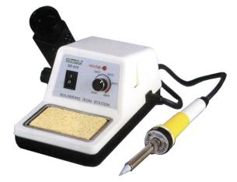
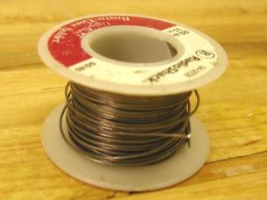
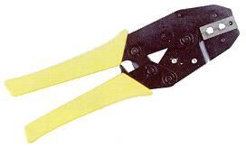
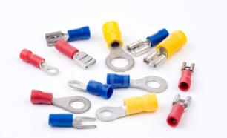
Tools and Materials
Tools and Materials
Soldering Iron
Solder
Crimping tool
Crimp Fittings

Slide 5
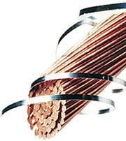
Conductors:
Conductors:
Conductors are defined as materials that allow the flow of electric current.
Metals are usually good conductors while nonmetals are not.
The most common conductor used in electrical wiring is copper.

Slide 6
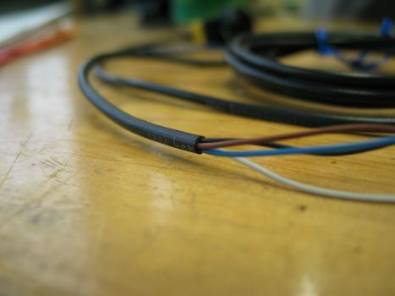
Insulators:
Insulators:
An insulator is a material that has few, if any, free electrons and resists the flow of electrons.
No material has been found to be a perfect insulator, but common insulators include air, glass, rubber, plastic, paper, and porcelain.
An advantage of using insulators in circuits, is that they provide the ability to place wires close together without the risk of a short circuit.

Slide 7
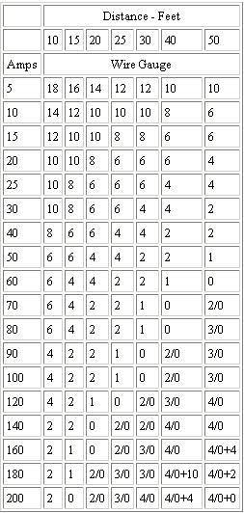
Choosing gauges:
Wire size for a 3% voltage drop in 12 Volt circuits
Choosing gauges:
The most important wiring practice is to observe proper wiring sizes.
Failure to choose the correct size can result in marginal performance of your circuit or even overheating of your wires or connectors.
Always use one size larger if possible.

Slide 8
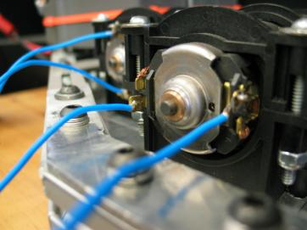
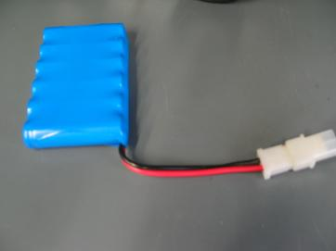
Wire Color Selection:
Wire Color Selection:
Properly choosing the colors for your wires can help you decipher your wiring configurations.
To the right is a picture of a bad configuration and a good configuration.
For low DC voltages use the following color codes:
Black – Negative
Red – Positive
Green - Ground

Slide 9
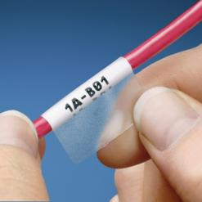
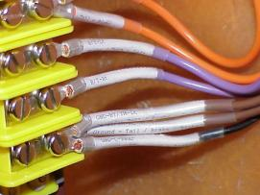
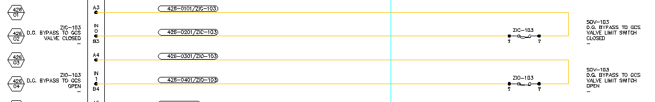
Wire Labels:
Wire Labels:
Label wires on both ends with source and destination designations.
Wire labels should match wire designation from wiring diagram.

Slide 10

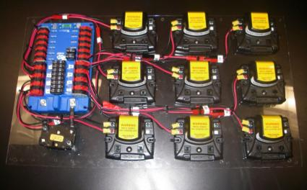
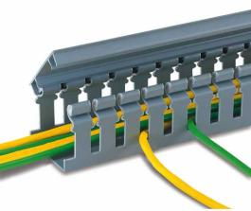
Wire Routing:
Wire Routing:
Route wires in neat, logical bundles.
Avoid twisting wires.
Avoid crossing over fasteners or equipment.
Use wire tray

Slide 11
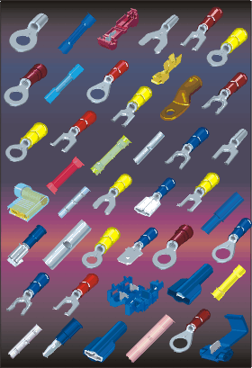
Wire Terminals and “Quick connects”:
Wire Terminals and “Quick connects”:
Terminals are used to safely and easily connect wires to a device or load.
They are usually crimped onto the ends of wires, or soldered directly onto the terminal.

Slide 12
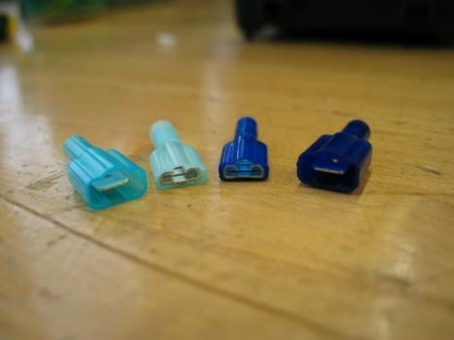
Advantages:
Advantages:
Single pole wire connectors
Allows a clean connection between the wires.
They can be “crimped” on instead of having to be soldered together.
You can safely separate the wires without having to cut or splice.

Slide 13

Soldering Wire:
Soldering Wire:

Slide 14
Wrap Up:
Why should we use a wire color code and wire labels?
To identify positive, negative, ground, or any other type of signals.
To identify source and destination of wire.
Why do we need to use insulators?
To prevent a short circuit connection and to protect you from shock and other safety reasons.
Why do we need to use conductors?
To connect electricity from one source to other components.
To complete an electrical path.
What happens to a light if you connect one lead to an insulator?
Nothing. Electricity doesn’t flow through an insulator.

